Slide 1
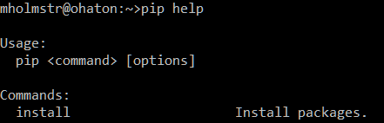
Setup
Download and install Python 3.10.4 or later via https://www.python.org/downloads/
Download and install the required external libraries as listed in the following slide with pip install <library> through the system command line interface

Slide 2
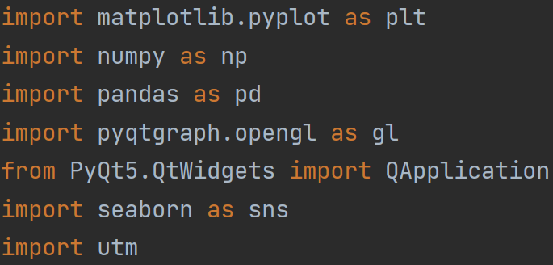
Required External Libraries
matplotlib
numpy
pandas
pyopengl
pyqt5
pyqtgraph
(OPTIONAL) scipy
seaborn
utm

Slide 3
Software Usage
Follow the steps in Setup then extract the Python files to the same directory
Run preprocess_given_datasets.py to convert provided datasets into a format that can be processed by the next two programs
Run plot_events_3d.py to visualise data in 3D
Run moving_window.py to perform moving window analysis in time or in space
Text prompts will guide the user for inputs with new windows opening for file selection and data visualisation

Slide 4
geospatial_conversion.py
Contains two functions for converting between representations of location data as needed for plotting and data analysis
Both get_cartesian and get_utm expect numpy arrays of latitude, longitude, and depth values as input (depth in kilometres, latitude and longitude in degrees)
Both functions return numpy arrays x, y, z representing positional data in kilometers

Slide 5
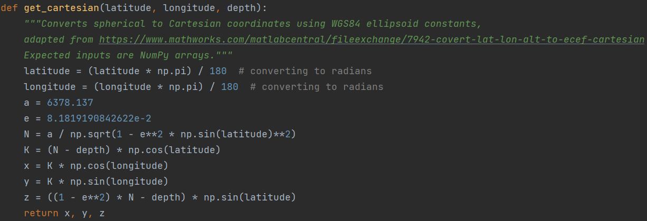
geospatial_conversion.py (2)
get_cartesian is used for projecting data to a spherical (ellipsoidal) model of the Earth

Slide 6
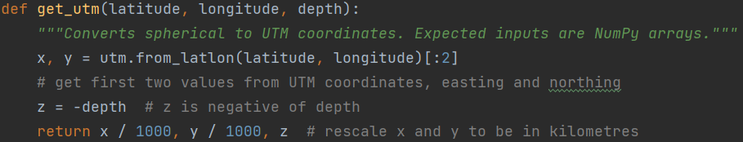
geospatial_conversion.py (3)
get_utm is used for projecting data to a planar (Universal Transverse Mercator) model of the Earth
The utm external library is used for simplicity and code efficiency

Slide 7
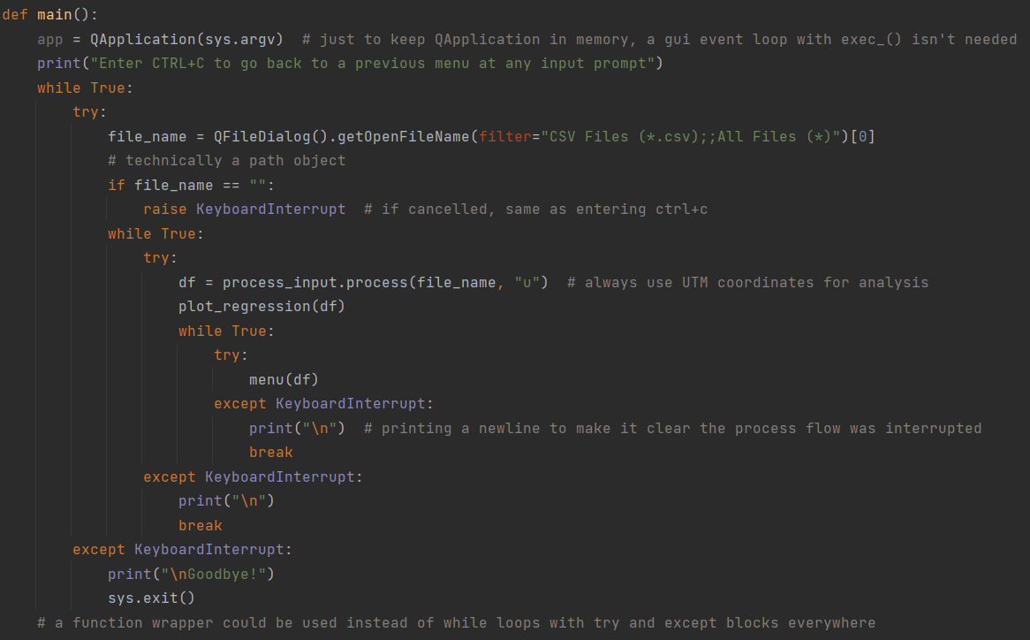
moving_window.py
Contains several functions for spatial and temporal moving window analysis
A Pandas dataframe generated as described in process_input.py will be returned and passed to the plot_regression and menu functions

Slide 8
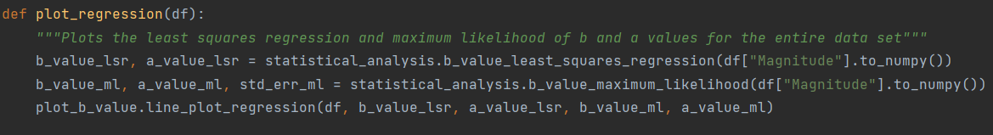
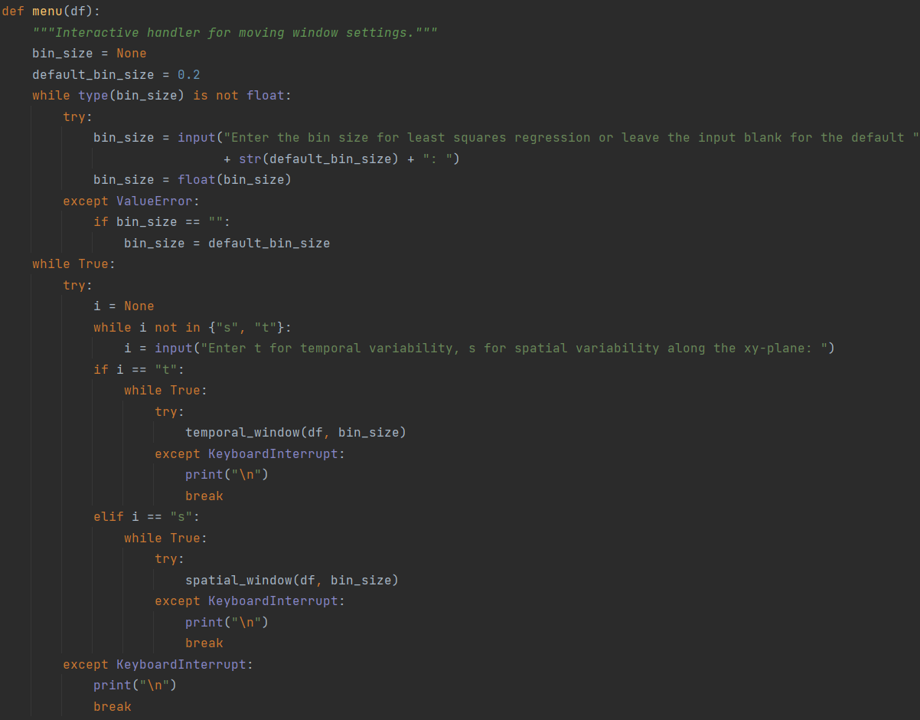
moving_window.py (2)
The plot_regression function plots summary statistics of the entire data set and then the menu function prompts for bin size and mode of the moving window analysis

Slide 9
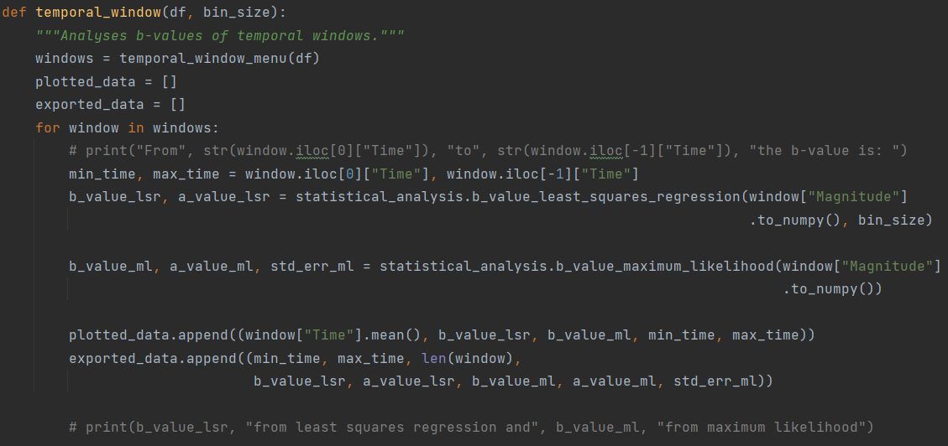
moving_window.py (3)
If time is the mode selected, the dataframe and bin size are passed to temporal_window
Individual windows are generated in temporal_window_menu and analysed here

Slide 10
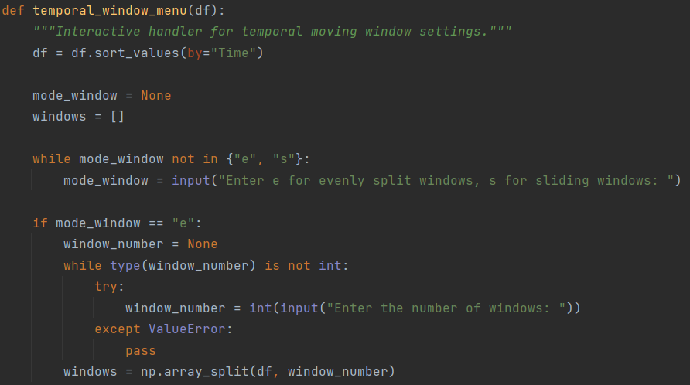
moving_window.py (4)
If windows are split evenly, the input prompts for the number of windows
np.array_split allows unequal divisions, oversized windows will have one extra event as needed

Slide 11
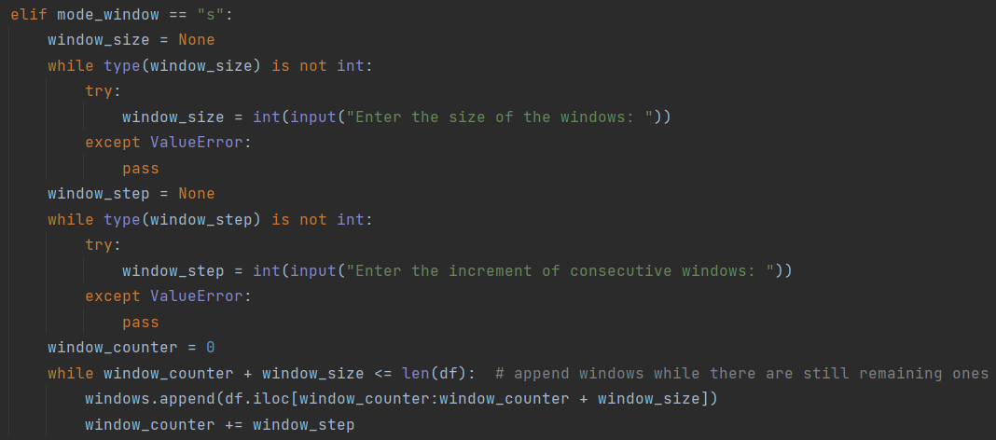
moving_window.py (5)
If windows are sliding, the input prompts for window size and how much they slide by
A simple while loop with a counter is used to split windows iteratively

Slide 12
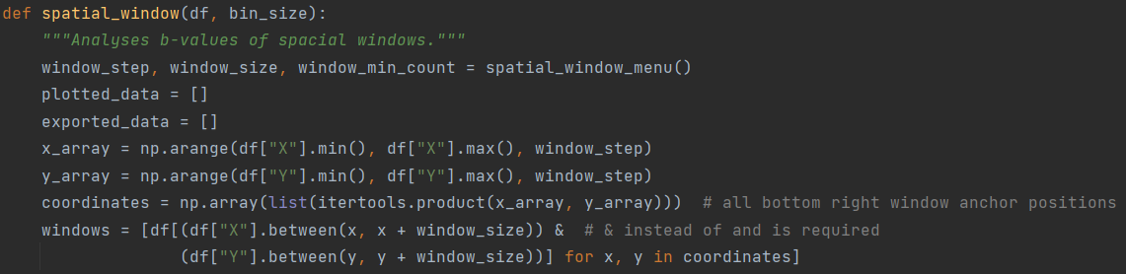
moving_window.py (6)
If space is the mode selected, window parameters are input in function spatial_window_menu and a cartesian product of all window positions is used to generate windows with list comprehension
Although faster than a nested for loop that processes windows iteratively, the process is still relatively slow when dealing with many windows and could be sped up by multi-threading and low-level algorithms that aren’t available in Pandas
For example: pre-sorting on X and Y then using binary search to find boundary indices for each window instead of a linear search through the entire dataframe each time

Slide 13
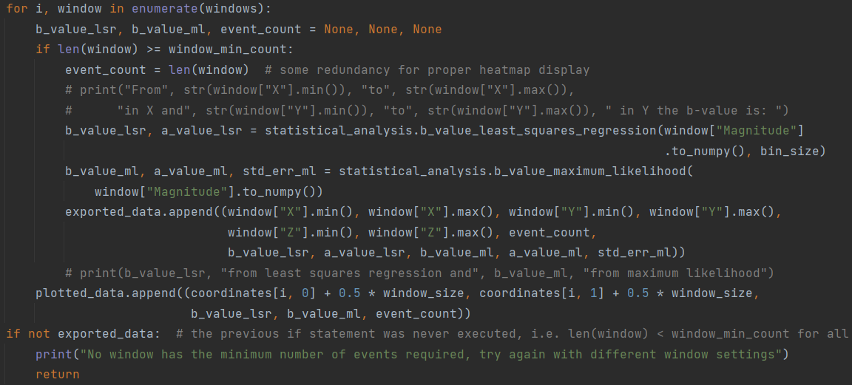
moving_window.py (7)
Windows that do not satisfy the minimum event count are still used as placeholders
To avoid a bug the function returns if there are no valid windows with the chosen window settings

Slide 14
moving_window.py (8)
Window data is plotted with functions described in plot_b_value.py
Separate functions are used for visualising and exporting data in both time and space analysis
Exported data is not identical to plotted data since they aggregate different values

Slide 15
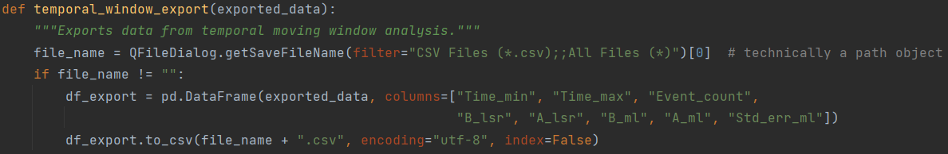
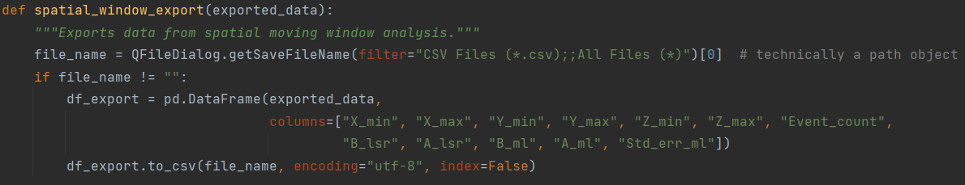
moving_window.py (9)
Exporting data is similar for temporal and spatial windows
Data is converted to a Pandas dataframe and the Pandas to_csv function writes the dataframe to a comma-separated values file

Slide 16
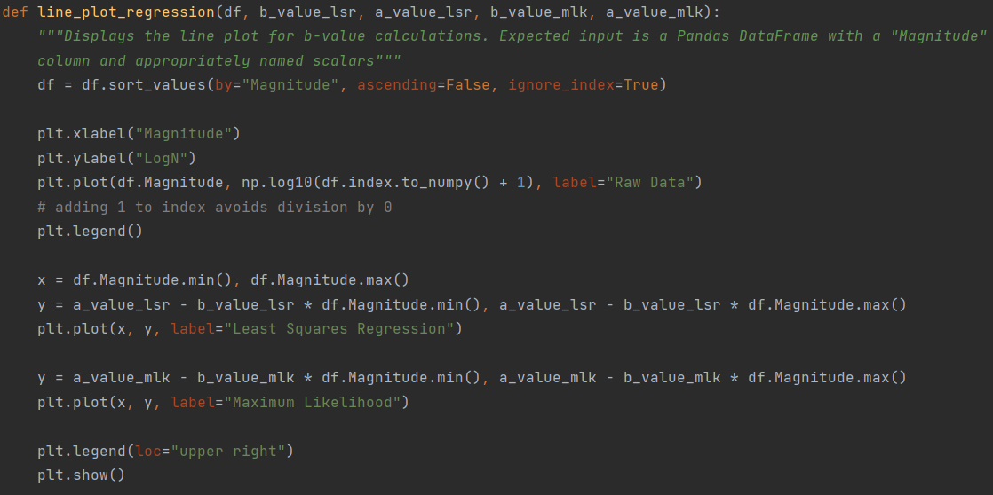
plot_b_value.py
Contains three functions for plotting data
line_plot_regression is used for evaluating results from least squares regression and maximum likelihood analysis by comparison with raw data

Slide 17
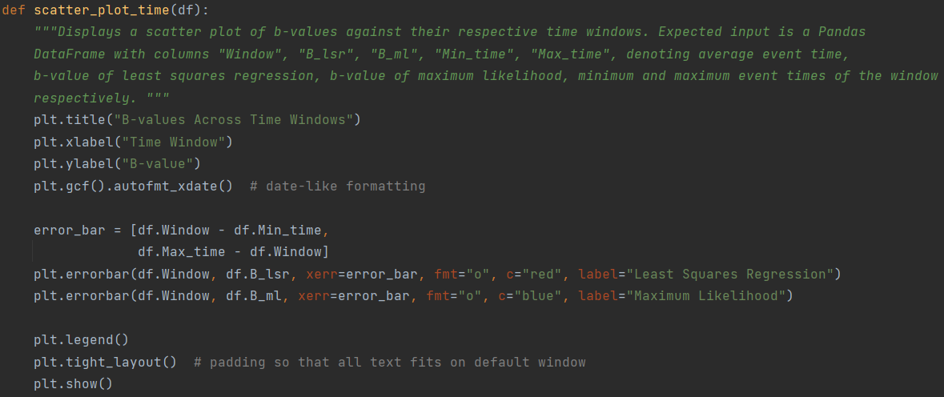
plot_b_value.py (2)
scatter_plot_time uses standard matplotlib scatterplot functions for temporal windows

Slide 18
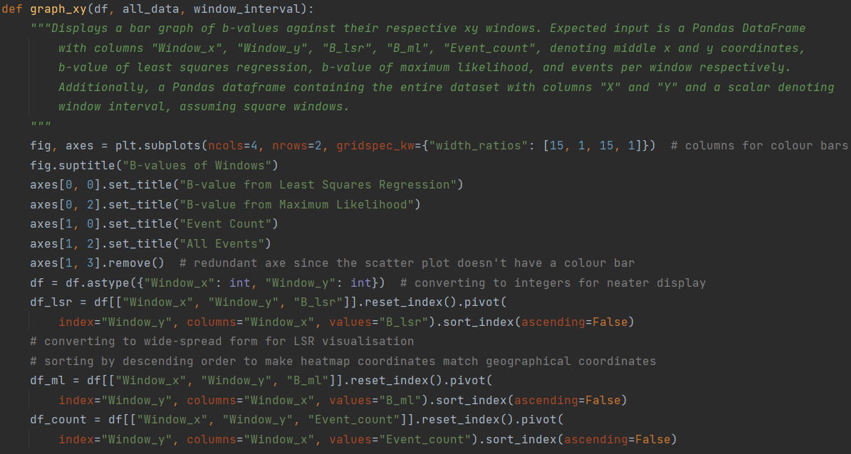
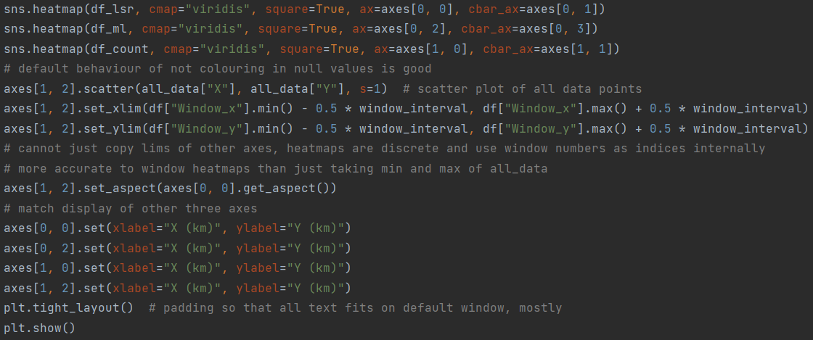
plot_b_value.py (3)
graph_xy uses seaborn heatmaps to display b-values (separately from LSR and MH) and event density for spatial windows as well as a matplotlib scatterplot to show overall event distribution in relation to windows
“All events” is slightly misleading because the scale does not include events outside the boundaries as established by the midpoint of the outermost window + window interval (heatmaps are non-intersecting)
This is most clearly seen when using large window sizes and small window intervals, with fewer windows resulting in more events being outside the scatterplot limits

Slide 19
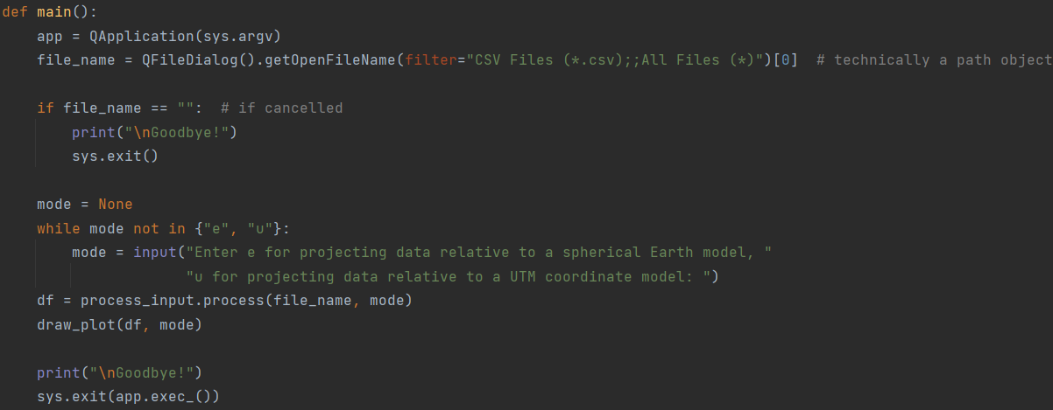
plot_events_3d.py
Contains several functions for plotting events in three-dimensional space with indicators for time and magnitude
Data filtering as described in process_input.py
Controls are clicking and dragging for rotation and scrolling for zoom

Slide 20
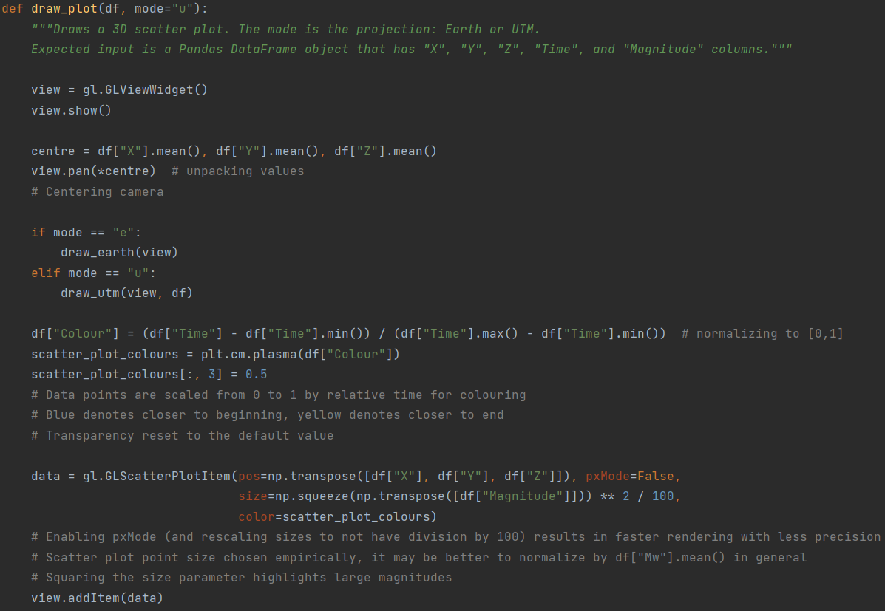
plot_events_3d.py (2)
Point colour is used to indicate time (delta)
Point size is used to indicate magnitude

Slide 21
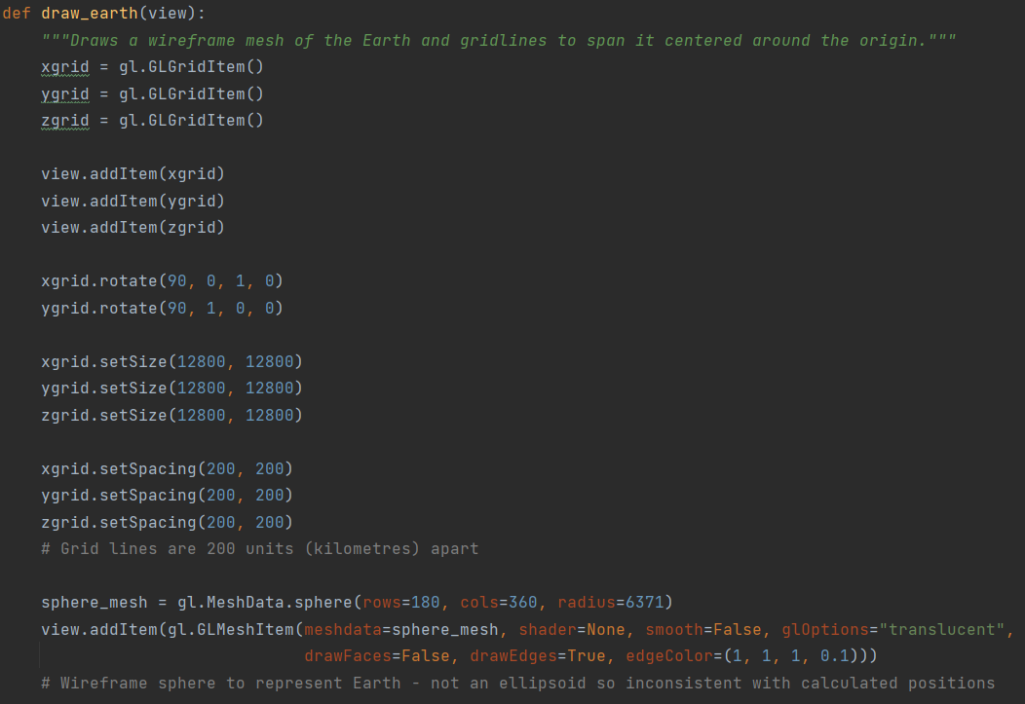
plot_events_3d.py (3)
Event data uses an ellipsoid Earth model if this mode is selected, but the difference is not significant enough against the wireframe

Slide 22
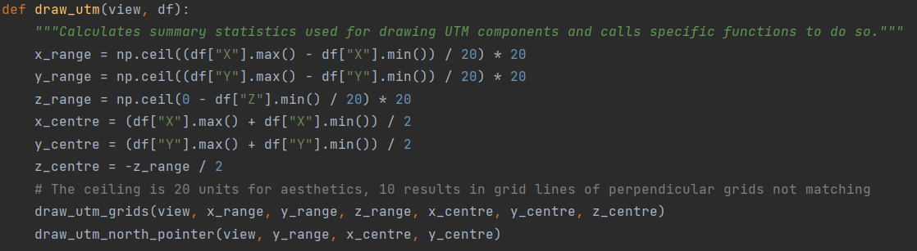
plot_events_3d.py (4)
Grids (also the north pointer) are dynamic if the UTM mode is selected and expand to cover the entire distribution of events with some extra room for even display

Slide 23
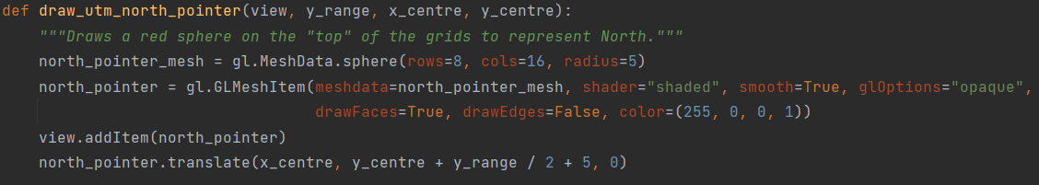
plot_events_3d.py (5)
One grid spans the XY plane and the other two depth grids are perpendicular to it and each other
The north pointer is simply a red sphere that is adjacent to the northernmost point on the XY grid, centered to the middle of the data

Slide 24
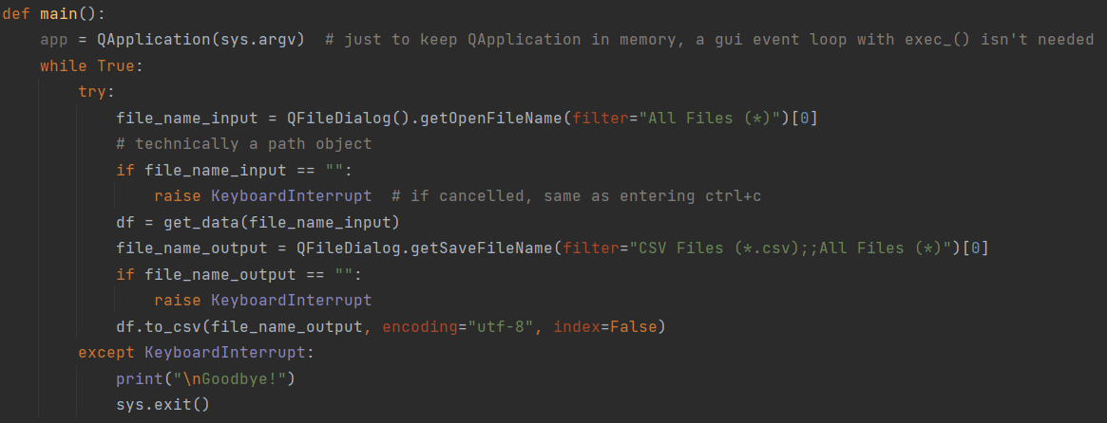
preprocess_given_datasets.py
Contains functions for converting provided datasets into a format that can be processed by programs that ask for CSV files as input
QFileDialog uses the system file dialog to open and save files which varies slightly by operating system

Slide 25
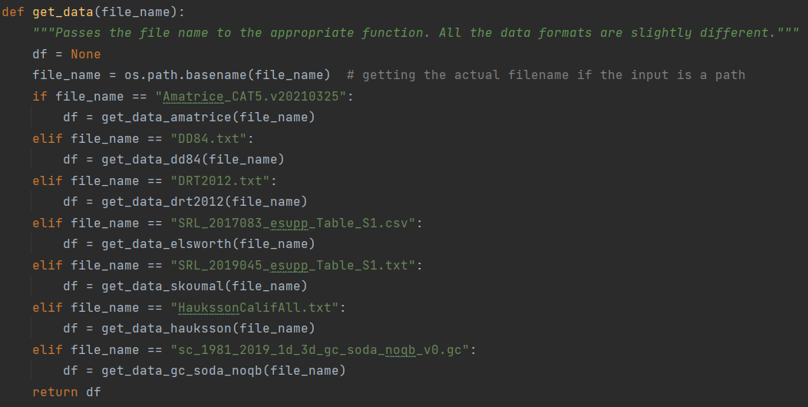
preprocess_given_datasets.py (2)
Separate processing is done for each data file that was provided because they all have different formats

Slide 26
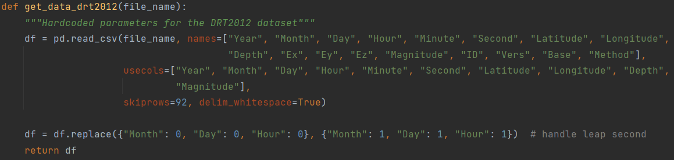
preprocess_given_datasets.py (3)
Exported columns are listed under usecols
In one case there was an interesting bug in the data recording program which made an event that took place on a leap second have invalid time values

Slide 27
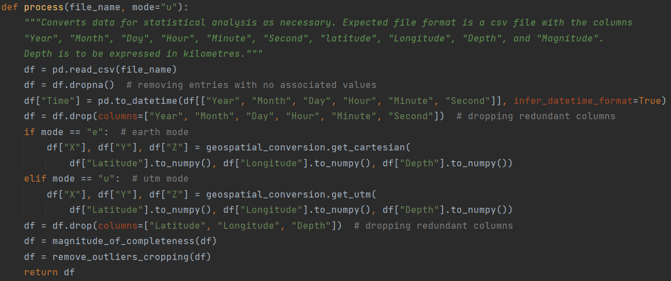
process_input.py
Contains functions for converting data with latitude/longitude/depth positional coordinates to x/y/z positional coordinates and separate time columns to one single datetime object column
Also filters data by magnitude of completeness and cropping on each of the spatial dimensions

Slide 28
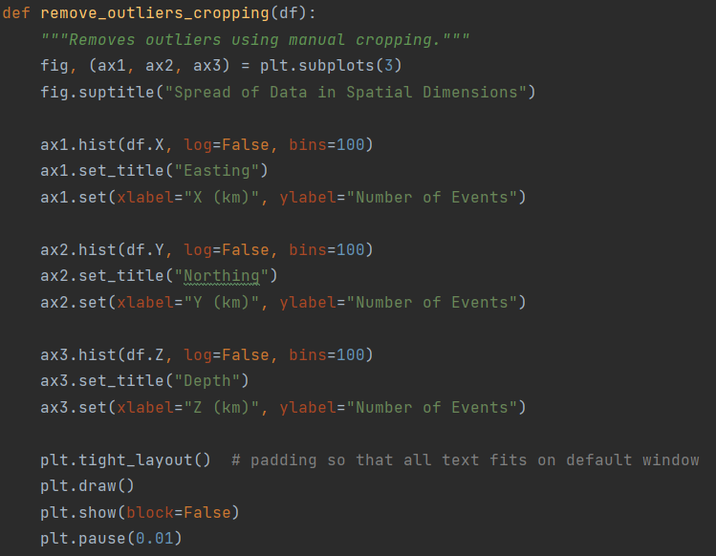
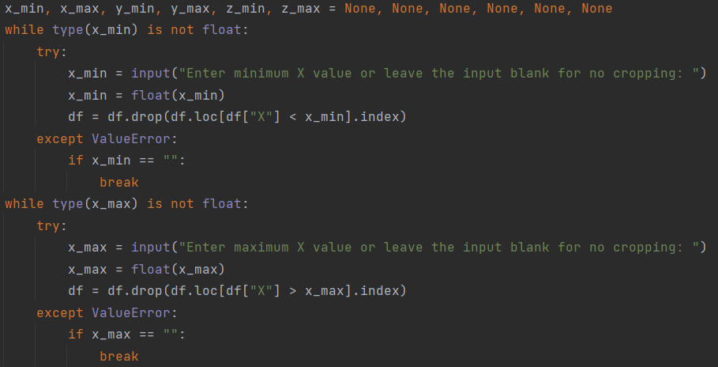
process_input.py (2)
Cropping displays three histograms for each of the spatial dimensions with 100 bins each and prompts for minimum and maximum values
Rows with values below or above the minimum and maximum, respectively, are dropped

Slide 29
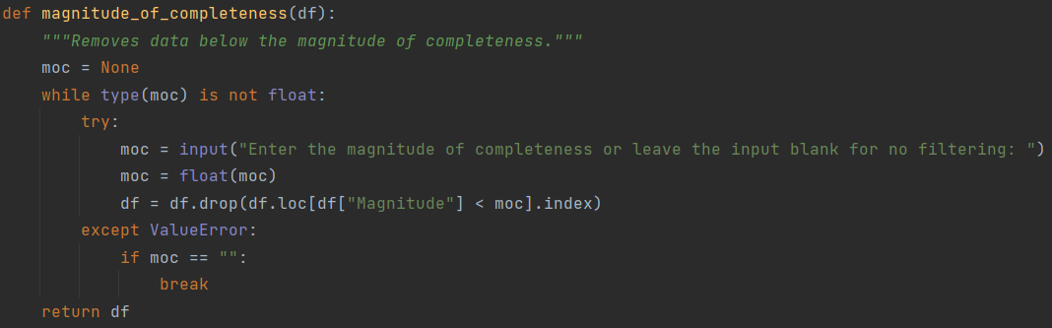
process_input.py (3)
Filtering by magnitude of completeness prompts for a magnitude of completion and drops rows with event magnitudes below it

Slide 30
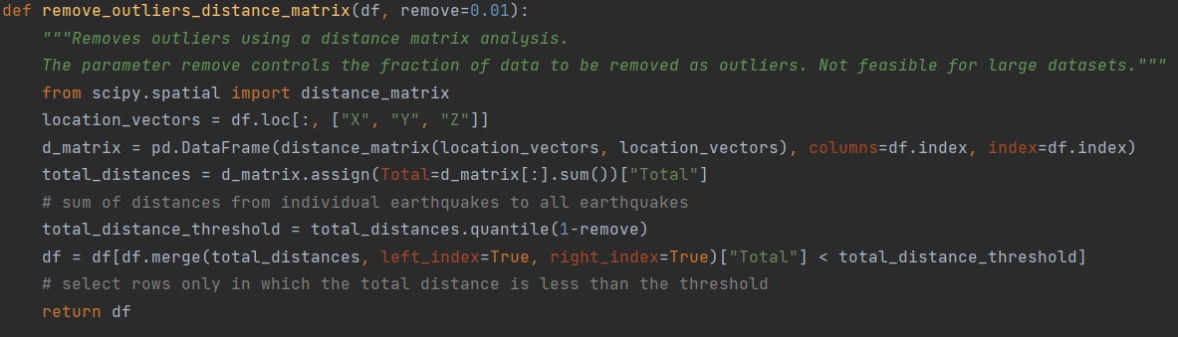
process_input.py (4)
An alternative mechanism for cropping by distance matrix outlier analysis remains in the code but is not used anywhere after turning out to be too slow
Memory efficiency could be improved to make it usable for large datasets by iteratively calculating distance vectors for each event but the run time would be even slower

Slide 31
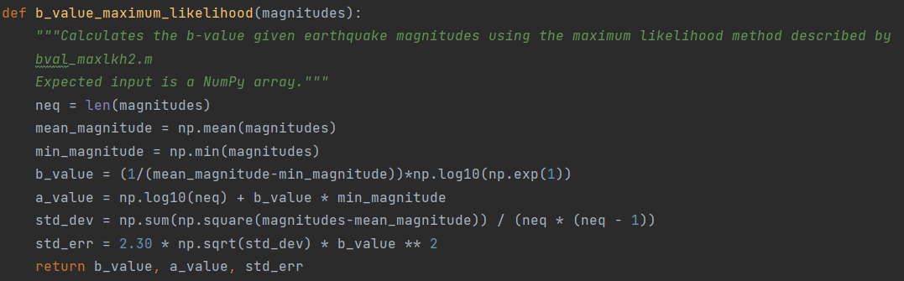
statistical_analysis.py
Direct transcription of Matlab code to Python that uses numpy for efficiency

Slide 32
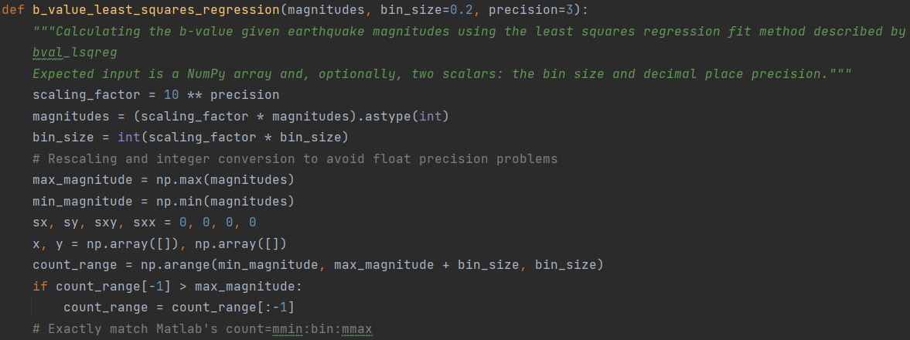
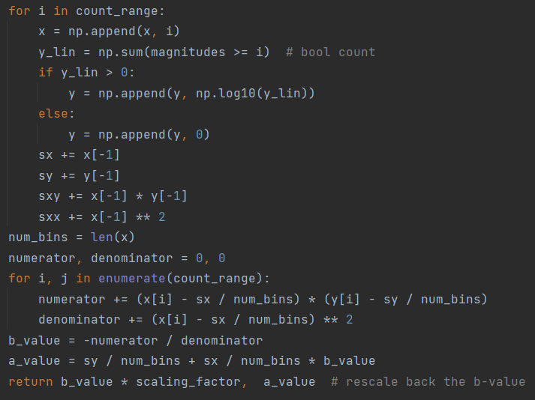
statistical_analysis.py (2)
Floating point magnitude values and bin size rescaled (by 3 decimal places as the default) and converted to integers to avoid issues with floating point numerical precision
Python for loops and numpy’s arange exclude the stopping point so an aditional value is added to the range and then and then dropped if unnecessary

